Slide 1
Recycling Textile Dyebath Using Conventional Methods And Membrane Technology
Arshad Chughtai
Department of Textile Engineering & Technology, University of the Punjab, Lahore 54590, Pakistan,
Email: achughtai@icet.pu.edu.pk

Slide 2
Contents
Background information
System analysis & optimization
Recycling techniques
Reconstitution of dyebath
Decomposition of dye(s)
Membrane technology
Comparison of recycling techniques
Conclusion

Slide 3
Importance of Water Recycling for Textile Dyeing Process
The textile dyeing process consumes a large quantity of water and also poses concern for environmental degradation
There exists considerable scope of water recycling to reduce water consumption and textile chemicals thus reducing the cost of production and pollution load
The dye bath recycling technology depends on the nature of dyes being used.

Slide 4
Benefits of Water Recycling
Reduced water cost
Reduced effluent treatment cost based on reduced COD and volume
Reduced process water softening costs
Energy saving due to greater availability of hot water
Saving in other process chemicals
Economic payback

Slide 5
System Analysis
Identification of water consumption and waste water output
Provide insight for direct reuse of low contaminated waste water
Provide bases for reclamation and recycling technologies
Provide guidelines for selection of machines and processes with optimum water usage

Slide 6
Optimization of water Recycling Processes
Optimization of rinsing and washing processes conserve large amount of water
Counter current washing leads to efficient reuse of water, four washing steps give 80% water saving
Improved dye machine design gives greater collection of dye bath for recycling
Right first time (RFT) approach minimize wastages of time, energy and chemicals
Improved control system increases efficiency of dyeing operation

Slide 7
Typical characteristics of waste water from textile dyeing
Component
Temperature
COD
BOD
TSS
Colour
Organic nitrogen
Value
30-80 C
50-5000 mg/l
200-300 mg/l
50-500 mg/l
> 300 mg/l
18 – 39 mg/l

Slide 8
Estimated degree of fixation for different dye fiber combinations
Class | Fiber | Fixation (%) | Loss to effluent (%)
Acid | Polyamide | 89 - 95 | 5 - 20
Direct | Cellulose | 70 - 95 | 5 - 30
Disperse | Polyester | 90 - 100 | 0 - 10
Reactive | Cellulose | 50 - 90 | 10 - 50
Sulfur | Cellulose | 60 - 90 | 10 - 40
Vat | Cellulose | 80 - 95 | 5- 20
Basic | Acrylic | 95 - 100 | 0- 5

Slide 9
Reuse of Spent Dye bath
Three methodologies
Reconstitution of Dye bath : Savings in water, dyes and chemicals
Decomposition of Dye bath : Savings in water and chemicals
Membrane technology :recovery of water, chemicals and
unexhausted dyestuff

Slide 10
Reconstitution of Dye bath
Applied for those dyes (direct, disperse, acid and basic) which are not decomposed during dyeing
Reconstitution of dye bath gives saving of water, dyes and auxiliaries
The procedure involves analysis of un exhausted dye bath and appropriate addition of dye for reuse
A mill used this technique and saved one million US $ per year and reduced salt discharge of 4 ton/day

Slide 11
Use of Spent Dye Bath Through Decomposition of Dyes
Recommended for dye bath containing reactive dyes
This technique saves water and salt
Ozonation technique is used for decomposition of dyes
Ozonation is influenced by pH, temperature, chemical structure of dyestuff, dye bath admixture, mass transfer characteristics of ozonating equipment
The cost of the process and the payback achieved will depend on size of the dye house, source of ozone and the amount of colour removal required.

Slide 12
Membrane Separation
Established process for water purification and recycling
Separates dissolved components from water and gives opportunities for producing clear hot water reuse
Modern membrane systems are compact and modular
High selectivity and low energy consumption
Highly reliable and more economical due to new technological innovation

Slide 13
Membrane technology : Pressure used
Reverse osmosis (RO) 3.0-6.0 MPa
Nanofiltration (NF) 2.0-4.0 MPa
Ultrafiltration (UF) 0.5-1.0 MPa
Microfiltration (MF) 0.1-0.4 MPa
Pressure

Slide 14
Membrane Processes
Microfiltration (MF) is suitable for removing suspended particles (micro-organism, colliods, inorganic particles). Rejection; Particles 98-100%, Salt 0%.
Ultrafiltration (UF) is effective for removal of particles and macromolecuels of dimensions higher than 10 nm, proteins, bacteria and viruses .The permeate can be reused for rinsing and washing purposes. Rejection; Protien 0-50%, Salt 5%.

Slide 15
Membrane Processes
Nanofiltration (NF) separate low molecular weight organic compounds and divalent salts, the permeate is acceptable for water reuse. Rejection; Monovalent salt 40-60%, Multivalent salts 95-100%.
Reverse osmosis (RO)removes ions and larger species from dyebath effluents. The permeate is colourless and low in salinity. Rejection; Salts 80-99.5%.

Slide 16
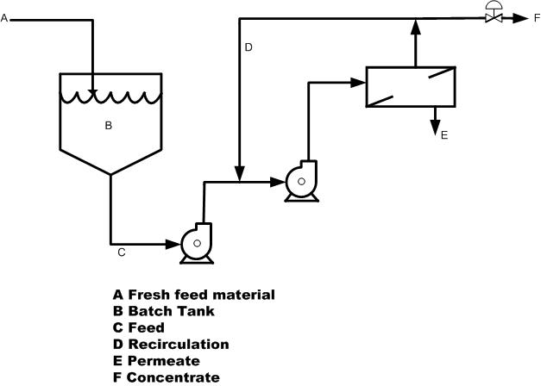
One Stage Continuous Membrane Operation

Slide 17
Bio-treatment Module
Biodegradation Module integrated with Membrane system
Sludge

Slide 18
Factors For Membrane Selection
The pore size of membrane : It determines what substances pass through the membrane and what substances are retained
The membrane material: It determine the chemical resistance and susceptibility to fouling
The membrane shape: It determines the susceptibility to clogging, the cleaning efficiency and the pre-treatment required.

Slide 19
Comparison of Processes
Reconstitution of dyebath: Least expensive, can be used for acid,direct and disperse dyes. Payback period is less than a year.
Decolorization by ozonation: Can be used for reactive, azo and vat dyes. More expensive but reclamation of salt and water makes it attractive. Pay back is 1-2 year.

Slide 20
Comparison of Processes
Membrane processes: Applicable for all dyes type. Reclamation of salt, water and dyes are possible. At the moment expensive but price will come down in future. Recommended for vertically integrated textile units. Pay back is 2-3 year.

Slide 21
Conclusion
The large consumption of water, energy and chemicals used by textile dyeing industry should be minimised
Sustainability demands recycling methodolgy
Reconstitution of dyebath is least expensive which can be applied for direct, acid and disperse dyes
Decomposition of dyes and subsequent reuse of dyebath can be implemented for reactive and vat dyes.
Relatively expensive with pay back period of two years
Membrane technology ensures high removal efficiency

Slide 22
Conclusion
Membrane technology purify water for reuse and also recovers valuables such as salt
The biodegradation can be integrated with membrane module to enhance its performance
Extensive research should be conducted at universities in the field of membrane technology for recycling and hence achievement of process intensification
The Textile Ministry, Smeda and Provincial EPA should provide technical support and arrange loans for small to medium units for implementation of recycling

Slide 23
THANK YOU ALL
From University of the Punjab

